Slide 1
Data Analysis with Python Libraries
There are two important Python Libraries imported for Data Analysis,
1. NumPy (Numerical Python)
A multidimensional array objects that comes with nice functions for data processing in these ndarrays.
Question: What is array? What is List? Difference?
2. Pandas (Panel Data)
Built over the stack of NumPy for better data analysis

Slide 2
Data Structures in Pandas
Pandas deals with the following three data structures
Series
DataFrame
Panel

Slide 3
Characteristics of Data Structures
Series (1D labeled homogeneous array, size is immutable)
DataFrame (Generally 2D labeled, size is mutable, tabular structure with potentially heterogeneously typed columns.
Panel (Generally 3D labeled, size is mutable)
These data structures are built on top of Numpy array, which means they are fast and provide better insight of data analysis.

Slide 4
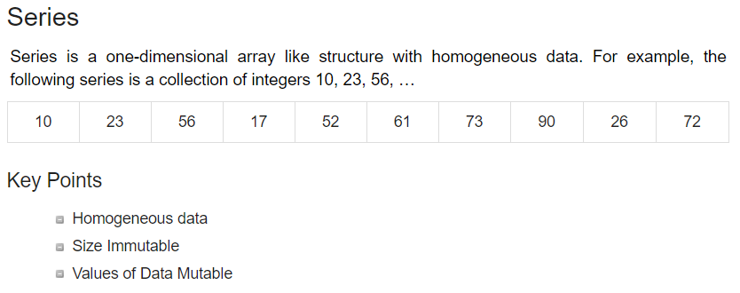
Examples of Data Structures

Slide 5
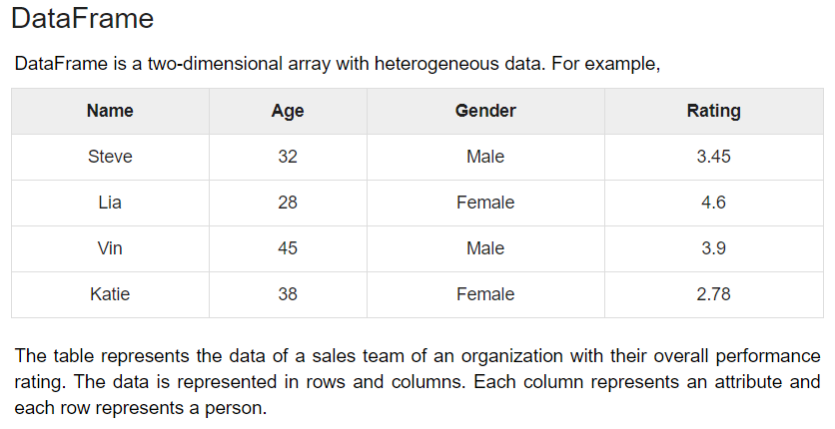
Examples of Data Structures Conti…

Slide 6
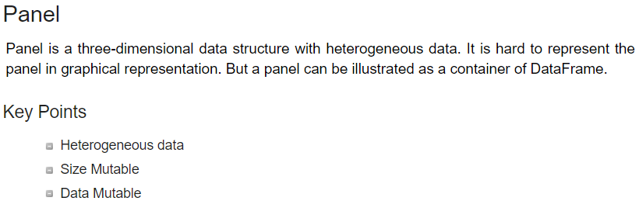
Examples of Data Structures Conti…

Slide 7
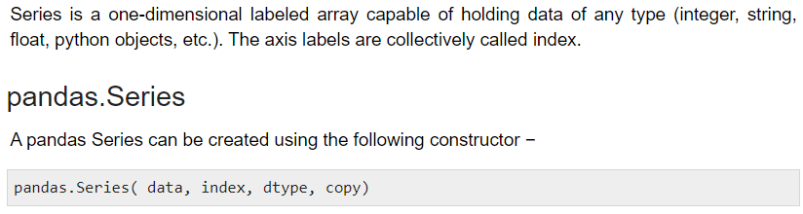





1. Series in Pandas

Slide 8
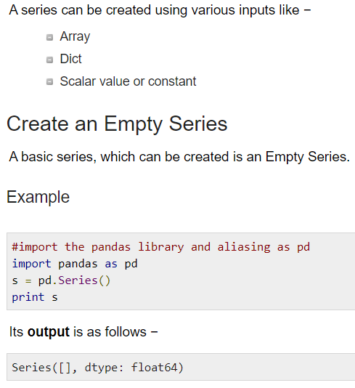
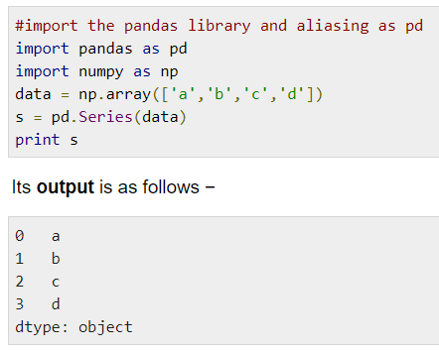
Create a Series from ndarray
If data is an ndarray, then index passed must be of the same length. If no index is passed, then by default index will be range(n) where n is array length, i.e., [0,1,2,3…. range(len(array))-1].
We did not pass any index, so by default, it assigned the indexes ranging from 0 to len(data)-1, i.e., 0 to 3.

Slide 9
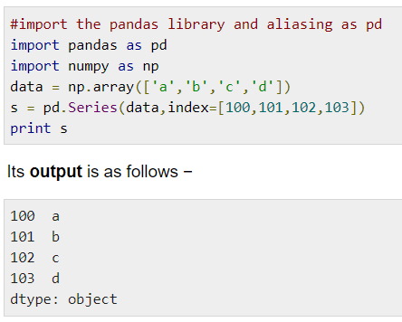
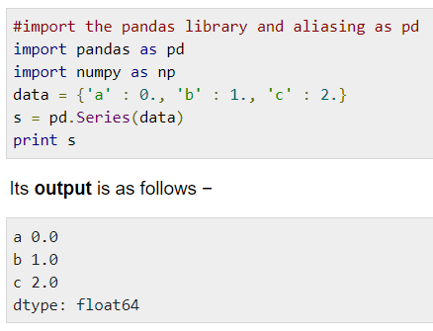
Create a Series specifying index
Create a Series from dict
A dict can be passed as input and if no index is specified, then the dictionary keys are taken in a sorted order to construct index.
We passed the index values here. Now we can see the customized indexed values in the output.
Dictionary keys are used to construct index

Slide 10
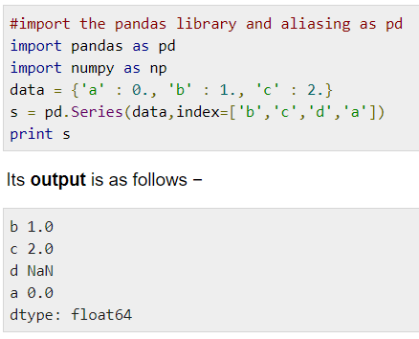
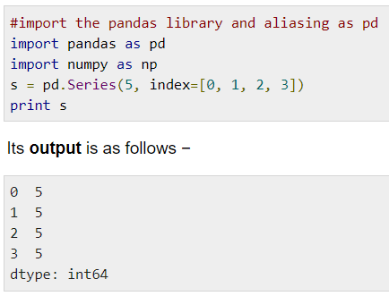
Create a Series specifying index
Create a Series from Scalar
If data is a scalar value, an index must be provided. The value will be repeated to match the length of index
Index order is persisted and the missing element is filled with NaN (Not a Number).

Slide 11
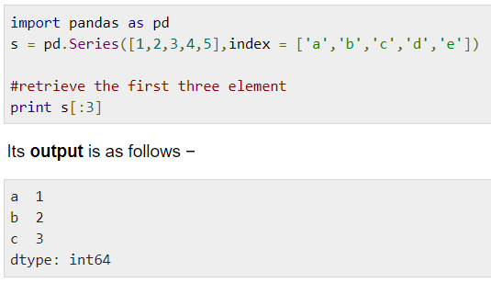
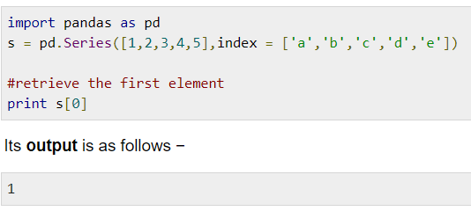
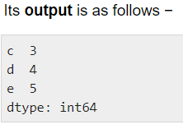
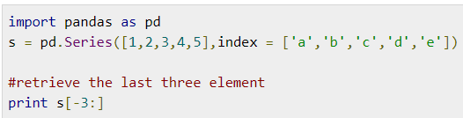
2
Retrieve the first three elements in the Series. If a : is inserted in front of it, all items from that index onwards will be extracted. If two parameters (with : between them) is used, items between the two indexes (not including the stop index)
Accessing Data from Series with Position
1
Retrieve the first element. As we already know, the counting starts from zero for the array, which means the first element is stored at zero^{th} position and so on.
3
Retrieve the last three elements.

Slide 12
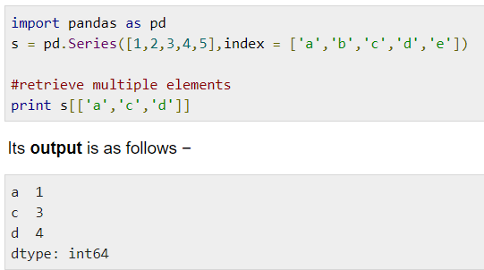
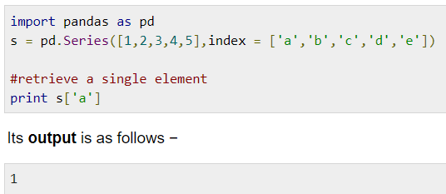
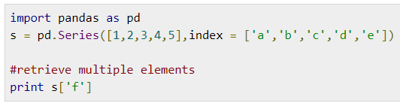
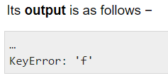
Retrieve Data Using Label (Index)
A Series is like a fixed-size dict in that you can get and set values by index label.
2
Retrieve multiple elements using a list of index label values.
1
3
If a label is not contained, an exception is raised.

Slide 13
Exercises
Create a Series of three objects, where each object is a list of marks of three subjects.
1
2
In exercise 1, Create index for these objects as students names so that each object represents a student having marks of three subjects each.

Slide 14
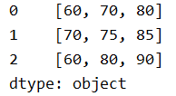
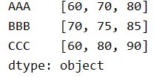
Solution of exercise 1 import pandas as pd data = [[60,70,80],[70,75,85],[60, 80, 90]] s = pd.Series(data) print(s)
Solution of exercise 2
import pandas as pd data = [[60,70,80],[70,75,85],[60, 80, 90]] s = pd.Series(data, index = ["AAA","BBB","CCC"]) print(s)

Slide 15
Attributes or Methods with Series
1 | axes Returns a list of the row axis labels
2 | dtype Returns the dtype of the object.
3 | empty Returns True if series is empty.
4 | ndim Returns the number of dimensions of the underlying data
5 | size Returns the number of elements in the underlying data.
6 | values Returns the Series as ndarray.
7 | head() Returns the first n rows.
8 | tail() Returns the last n rows.

Slide 16

Attributes or Methods with Series
import pandas as pd import numpy as np s = pd.Series(np.random.randn(4)) print (s) print ("The axes are:",s.axes) print ("The data type of object is ",s.dtype) print ("Is the Object empty?",s.empty) print ("The dimensions of the object:",s.ndim) print ("The size of the object:",s.size) print ("The actual data series is:",s.values) print ("The first two rows of the data series:", s.head(2)) print ("The last two rows of the data series:", s.tail(2))
1 | axes
2 | dtype
3 | empty
4 | ndim
5 | size
6 | values
7 | head()
8 | tail()

Slide 17
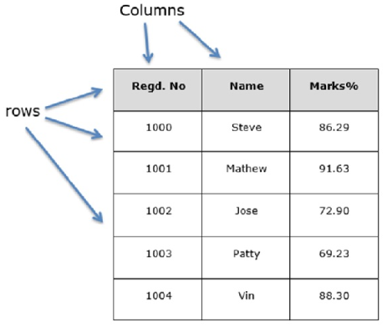
DataFrame A Data frame is a two-dimensional data structure, i.e., data is aligned in a tabular fashion in rows and columns.
Features of DataFrame
Potentially columns are of different types
Size – Mutable
Labeled axes (rows and columns)
Can Perform Arithmetic operations
on rows and columns

Slide 18
pandas.DataFrame( data, index, columns, dtype, copy)
data
data takes various forms like ndarray, series, map, lists, dict, constants and also another DataFrame.
index
For the row labels, the Index to be used for the resulting frame is Optional Default np.arrange(n) if no index is passed.
Columns
For column labels, the optional default syntax is - np.arrange(n). This is only true if no index is passed.
dtype
Data type of each column.
copy This command (or whatever it is) is used for copying of data, if the default is False.

Slide 19
Create DataFrame A pandas DataFrame can be created using various inputs like Lists dict Series Numpy ndarrays Another DataFrame

Slide 20
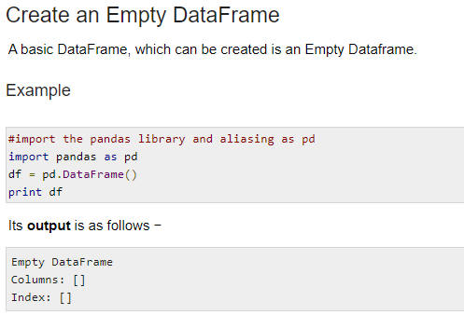

Slide 21
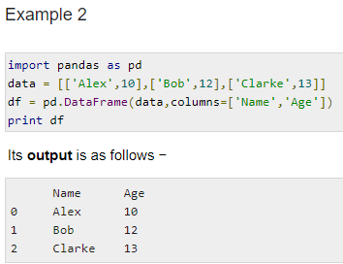
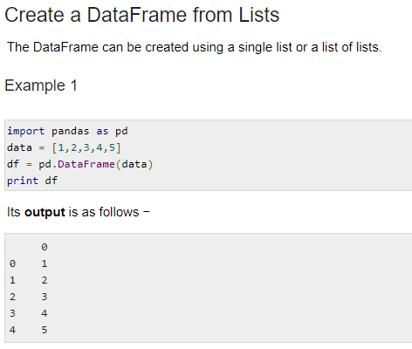
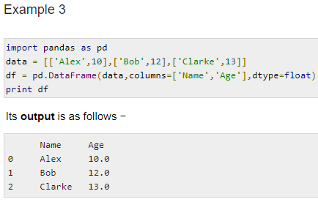

Slide 22
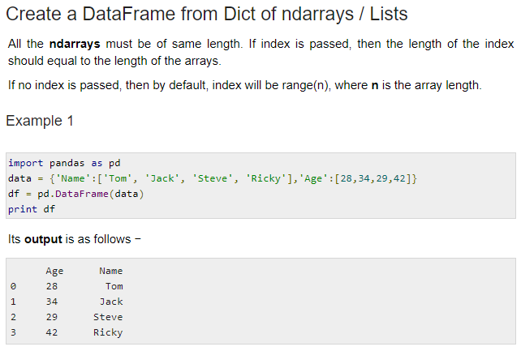

Slide 23
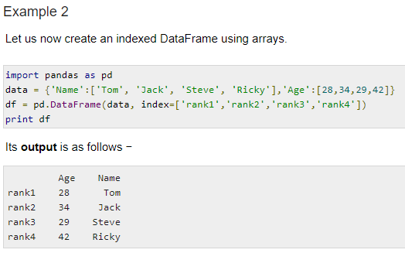

Slide 24
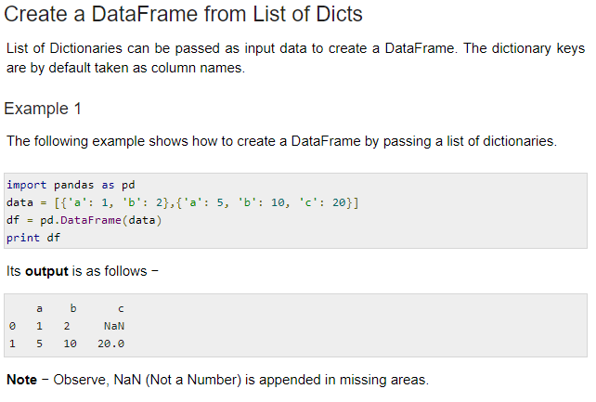

Slide 25
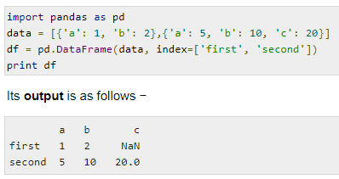
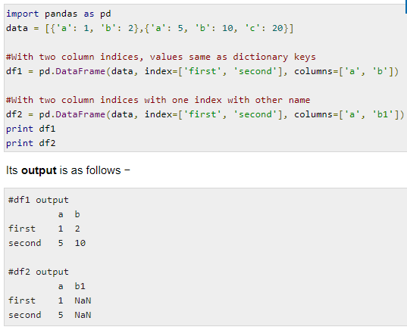
Example 2
The following example shows how to create a DataFrame by passing a list of dictionaries and the row indices.
Example 3
The following example shows how to create a DataFrame with a list of dictionaries, row indices, and column indices.
Observe and conclude the output of Example 3
???????

Slide 26
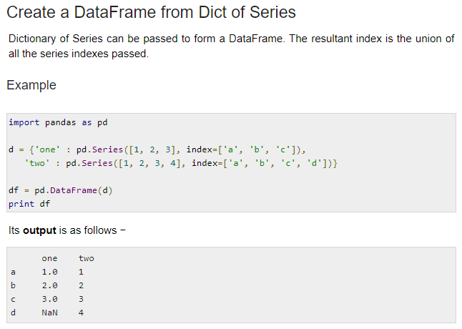

Slide 27
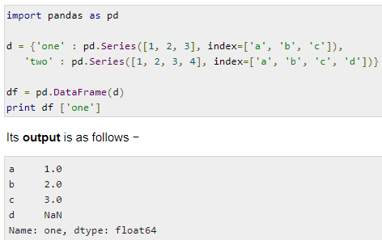
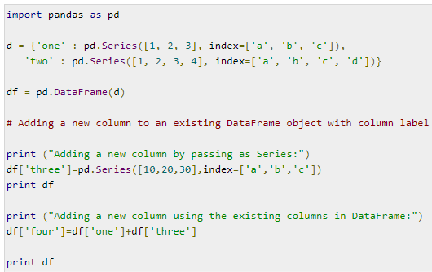
Column Selection
Column Addition
Type, Run and Check the Output ????

Slide 28
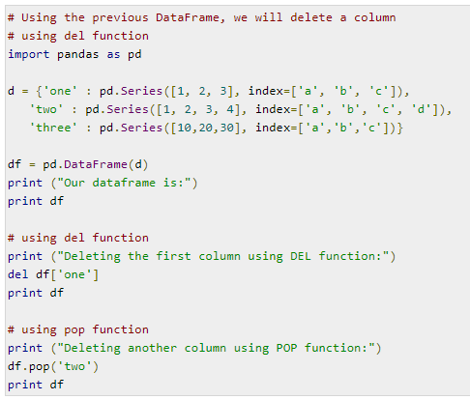
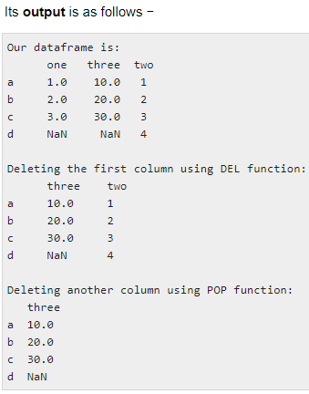
Column Deletion

Slide 29
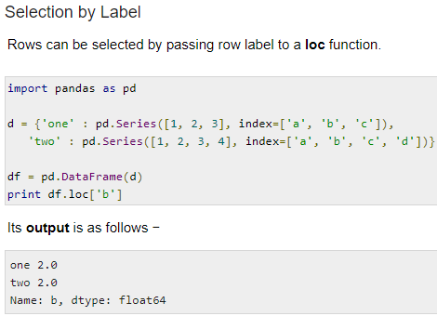
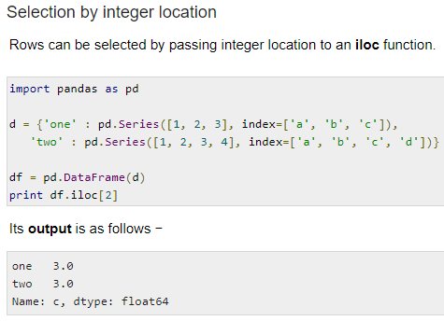
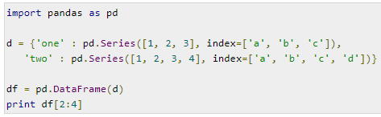
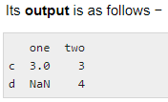
Row Selection, Addition, and Deletion
Slice Rows
Multiple rows can be selected using ‘ : ’ operator.

Slide 30
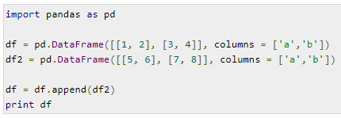
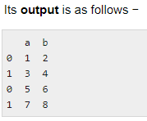
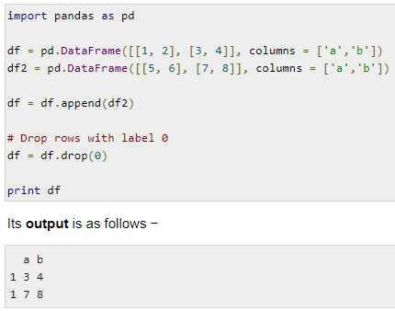
Addition of Rows
Add new rows to a DataFrame using the append function. This function will append the rows at the end.
Deletion of Rows
Use index label to delete or drop rows from a DataFrame. If label is duplicated, then multiple rows will be dropped.
If you observe, in the above example, the labels are duplicate. Let us drop a label and will see how many rows will get dropped.

Slide 31
Attributes or Methods with DataFrame
T (Transposes rows and columns) axes (Returns a list of the row axis labels)
dtype (Returns the dtype of the object)
empty (Returns True if series is empty)
ndim (Returns the number of dimensions of the underlying data)
size (Returns the number of elements in the underlying data) Shape (Returns a tuple representing the dimensionality of dataframe)
values (Returns the Series as ndarray)
head() (Returns the first n rows)
tail() (Returns the last n rows)

Slide 32
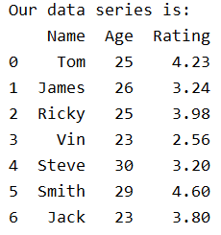
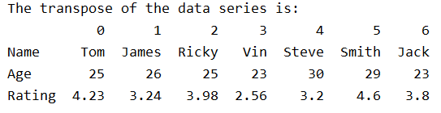
import pandas as pd import numpy as np d = {'Name':pd.Series(['Tom','James','Ricky','Vin','Steve','Smith','Jack']),
'Age':pd.Series([25,26,25,23,30,29,23]), 'Rating':pd.Series([4.23,3.24,3.98,2.56,3.20,4.6,3.8])} df = pd.DataFrame(d) print ("Our data series is:") print (df)
print ("The Row Axes Labels and Columns Excel labels are ") print (df.axes)
print ("The transpose of the data series is:") print (df.T)

Slide 33
Attributes or Methods with DataFrame
dtype
empty
Ndim Shape
size
values
head()
tail()
import pandas as pd import numpy as np d = {'Name':pd.Series(['Tom','James','Ricky','Vin','Steve','Smith','Jack']),'Age':pd.Series([25,26,25,23,30,29,23]), 'Rating':pd.Series([4.23,3.24,3.98,2.56,3.20,4.6,3.8])} df = pd.DataFrame(d) print ("The data types of each column are:",df.dtypes) print ("Is the object empty?", df.empty) print ("The dimension of the object is:",df.ndim) print ("The shape of the object is:", df.shape) print ("The total number of elements in our object is:", df.size) print ("The actual data in our data frame is:",df.values) print ("The first two rows of the data frame is:", df.head(2)) print ("The last two rows of the data frame is:", df.tail(2))

Slide 34
Descriptive Statistical Functions
No. | Function | Description
1 | count() | Number of non-null observations
2 | sum() | Sum of values
3 | mean() | Mean of Values
4 | median() | Median of Values
5 | mode() | Mode of values
6 | std() | Standard Deviation of the Values
7 | min() | Minimum Value
8 | max() | Maximum Value
9 | abs() | Absolute Value
10 | prod() | Product of Values
11 | cumsum() | Cumulative Sum
12 | cumprod() | Cumulative Product

Slide 35
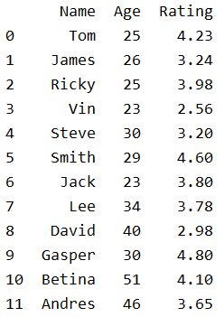
import pandas as pd import numpy as np d = {'Name':pd.Series(['Tom','James','Ricky','Vin','Steve','Smith','Jack', 'Lee','David','Gasper','Betina','Andres']), 'Age':pd.Series([25,26,25,23,30,29,23,34,40,30,51,46]), 'Rating':pd.Series([4.23,3.24,3.98,2.56,3.20,4.6,3.8,3.78,2.98,4.80,4.10,3.65]) } df = pd.DataFrame(d) print (df)
Create the above dataframe and check its output

Slide 36

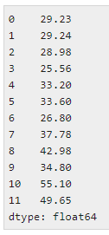
DataFrame − “index” (axis=0, default), “columns” (axis=1)
print (df.axes)
Previous Example Code goes on and do the followings
print (df.sum())
Returns the sum of the values for the requested axis. By default, axis is index (axis=0).
print (df.sum(1))

Slide 37


Previous Example Code goes on and do the followings
print df.mean()
print df.std()
Assignment: Test all the functions and see what they output

Slide 38
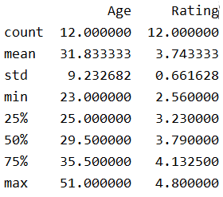
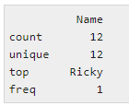
import pandas as pd import numpy as np d = {'Name':pd.Series(['Tom','James','Ricky','Vin','Steve','Smith','Jack', 'Lee','David','Gasper','Betina','Andres']), 'Age':pd.Series([25,26,25,23,30,29,23,34,40,30,51,46]), 'Rating':pd.Series([4.23,3.24,3.98,2.56,3.20,4.6,3.8,3.78,2.98,4.80,4.10,3.65]) } df = pd.DataFrame(d) print (df.describe())
print df.describe(include=['object'])
print df.describe(include=‘all’)
Test it

Slide 39
Test these with previous code and understand
df.ColumnName.describe()
df.describe(include=[np.number])
df.describe(include=[np.object])
df.describe(include=[‘category'])
df.describe(exclude=[np.number])
df.describe(exclude=[np.object])

Slide 40
Saving DataFrame to a CSV File ????

Slide 41
References
Pandas Python Documentation
https://pandas.pydata.org/pandas-docs/version/0.25/reference/frame.html
Python Tutorials
https://www.tutorialspoint.com/python_pandas
https://www.w3schools.com/python/python_intro.asp
https://www.youtube.com/watch?v=e60ItwlZTKM

